Slide 1

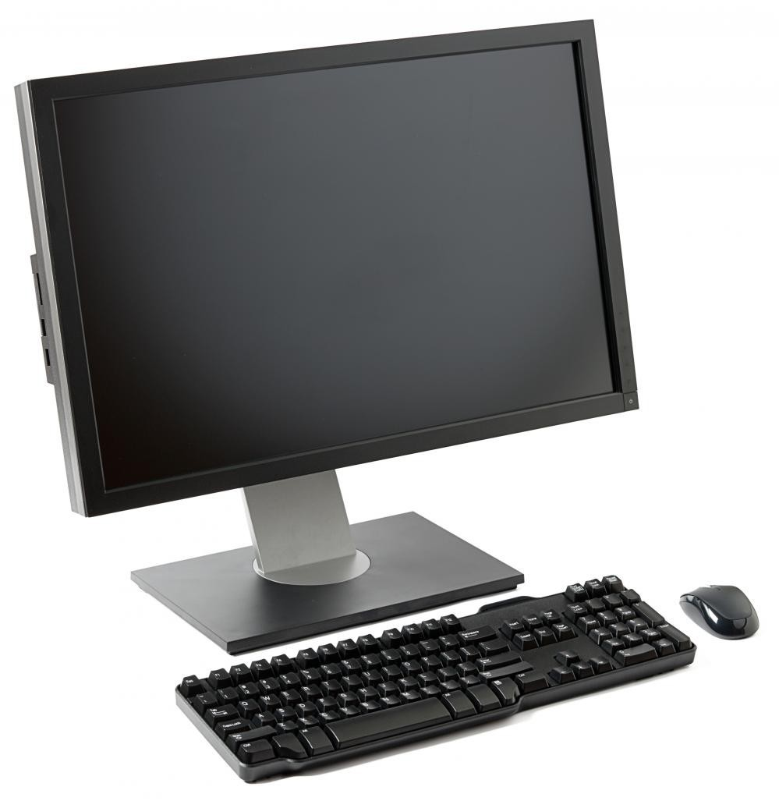
Characteristics of Computers
Presented By- Vishant Kumar
Assistant Professor
Computer Science & Engineering Department
Tula’s Institute, Dehradun

Slide 2
Computer
➢
Comes from the word "Compute"
➢
Compute means to "Calculate"
➢
So Computer is calculating device
➢
Perform calculations at enormous speed
➢
Computer is device that operates upon "Data"or"Information"
➢
e.g.preparing result,calculations,transactions,scientific work etc

Slide 3
Computer
➢
Computer
can
input "Data"
➢
Computer
can
process "Data"
➢
Computer
can
store "Data"
➢
Computer
can
retrieve "Data"
Finally...
Computer can be term
as "Data
Processor"

Slide 4
Characteristics
of
Computer
1.
2.
3.
4.
5.
6.
7.
Speed
Accuracy
Diligence
Versatility
Power of remembering
No I.Q
No Feelings

Slide 5
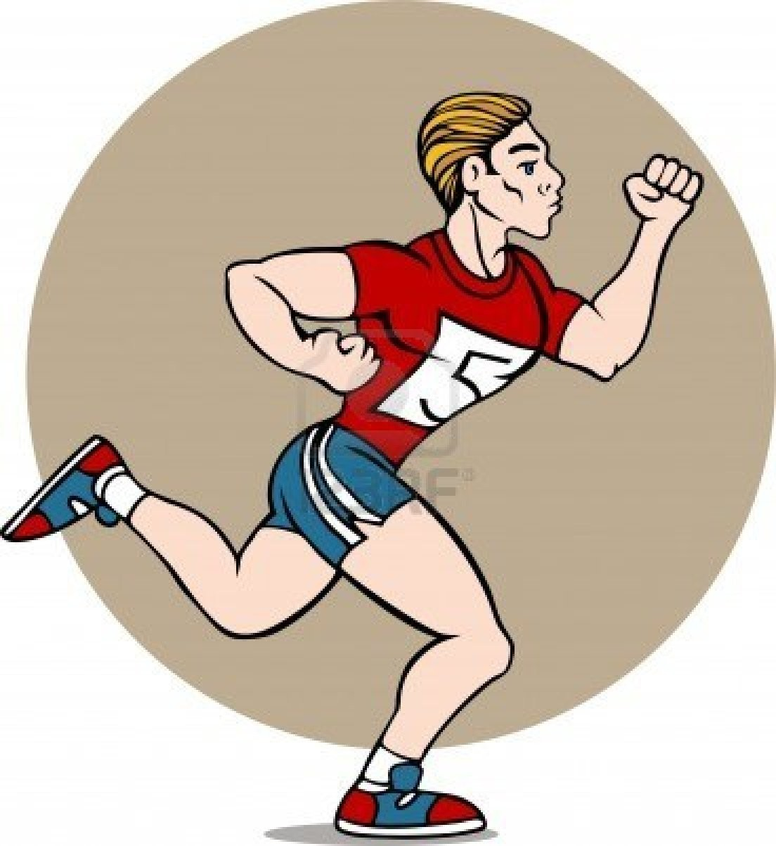
...Characteristics of Computer...
Speed...
➢
Fast device
➢
Work done as enormous speed as compare
to human beings
➢
Speed of Computer is meaured in term
microseconds,nanoseconds,and ever
picoseconds

Slide 6
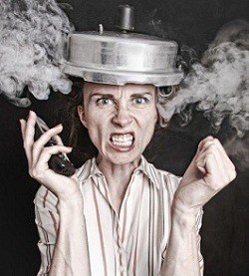
...Characteristics of Computer...
Accuracy...
➢
Work with the higgest
Accuracy
➢
Accuracy depends upon
the
"Design of Computer"
➢
Human Errors are like wrong
command, inaccurate data
input etc

Slide 7
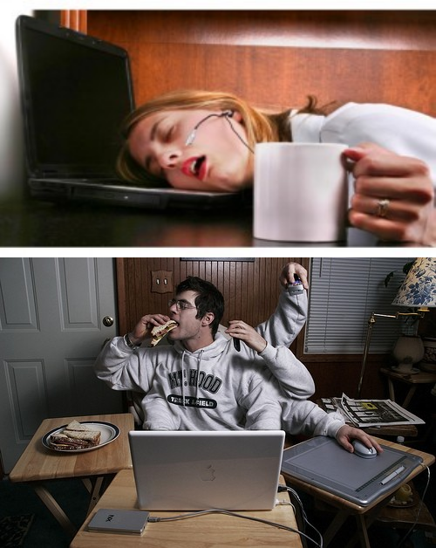
...Characteristics of Computer...
Diligence...
➢
Free
from "monotony"
➢
Free
from "Tiredness"
➢
Free
from Lack of
"Consentration"

Slide 8
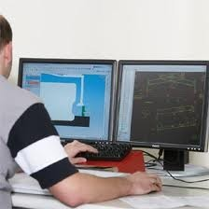
...Characteristics of Computer...
Versatility...
•
Can perform all kind of job
simultaneously
•
Can do diverse nature of
works like
calculations,graphics
work,searching etc at the
same time

Slide 9

...Characteristics of Computer...
Power of Remembering...
•
Unlike human being Computer can store huge amount of data
•
Doesn't differentiate "Important" & "Not Important"
•
Loss or Deletion of data is done by User

Slide 10
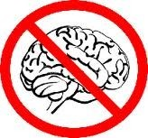
...Characteristics of Computer...
No
IQ...
•
Not
A thinking
machine
•
Not
Intelligent
•
Never does a task as it own
•
Follow human Instuctions

Slide 11
...Characteristics of Computer...
No Feeling...
•
Follow Human
Instructions
•
Never decides
at its own
•
No
taste
•
No
emotions
•
No
knowledge

Slide 12
THANK YOU…

